Slide 1
Multi-Agent Efficiency: Parallel vs. Sequential Processing Diya – 2210990300
Diya Raina - 2210990304
Supervised By
Prof. Dr. S. B Goyal
Department of Computer Science and Engineering,
Chitkara University, Punjab

Slide 2
Abstract
Artificial intelligence systems are rapidly evolving from traditional monolithic models toward distributed multi-agent architectures. Monolithic models perform all computations within a single system, while multi-agent systems divide tasks among multiple specialized agents that collaborate to solve complex problems. Although multi-agent systems improve flexibility, scalability, and reasoning quality, they also introduce additional computational costs due to communication and coordination among agents.
This research compares monolithic AI systems with multi-agent architectures using both parallel and sequential processing approaches. The study evaluates their performance using metrics such as execution time, energy consumption, and computational efficiency. Real-time monitoring tools like CodeCarbon are used to measure energy usage during task execution.
The findings show that monolithic systems are more energy-efficient for simple tasks because they avoid communication overhead. However, for complex workflows requiring verification, refinement, and collaboration, multi-agent systems produce better-quality outputs and higher reliability. Parallel processing reduces execution time but increases energy usage, while sequential processing improves coordination at the cost of slower execution.
Overall, the research highlights the importance of balancing performance and sustainability in AI system design and recommends adaptive hybrid architectures that dynamically select the most efficient processing strategy.

Slide 3
Introduction
Artificial intelligence systems have evolved significantly from simple rule-based programs to highly advanced deep learning architectures capable of solving complex real-world problems. Traditionally, AI systems were designed as monolithic models in which a single large model performs all required operations independently. These systems provide strong reasoning capabilities and high-quality outputs but require enormous computational resources, including high-performance GPUs, extensive memory, and large amounts of electricity.
To overcome these limitations, researchers introduced multi-agent systems, where multiple specialized agents collaborate to solve tasks collectively. Instead of relying on a single large model, these systems distribute responsibilities among different agents such as processing agents, verification agents, and refinement agents.
However, the collaboration between agents creates a new challenge known as communication overhead. Since agents must continuously exchange information, synchronize tasks, and coordinate decisions, additional computational power and energy are consumed. This extra cost is referred to in this research as the “energy tax” of multi-agent systems.
The study investigates how different processing methods - parallel and sequential processing - affect execution speed, energy usage, and overall efficiency in both monolithic and distributed AI architectures.

Slide 4
Core Concept
The central idea of this research is to analyze how AI architectures influence computational efficiency and energy consumption. The study compares two major AI approaches: monolithic systems and multi-agent systems.
In a monolithic system, a single model handles the entire workflow internally. This reduces communication overhead and enables faster execution for straightforward tasks. However, as task complexity increases, monolithic systems struggle with scalability and maintaining reasoning accuracy over multiple stages.
In contrast, multi-agent systems divide work among several specialized agents. Each agent performs a dedicated function, such as planning, verification, analysis, or refinement. This collaborative structure improves flexibility, modularity, and problem-solving quality for complex tasks.
The study also examines two processing techniques:
- Parallel Processing - multiple agents work simultaneously
- Sequential Processing - agents execute tasks one after another
Parallel processing reduces execution time but consumes more energy due to simultaneous computation and synchronization. Sequential processing improves coordination and stability but increases total execution time.
The research demonstrates that selecting the correct architecture and processing method based on task complexity is essential for achieving a balance between performance and sustainability.

Slide 5
Literature Review
Earlier research in artificial intelligence mainly focused on improving the reasoning capability and accuracy of large monolithic models such as GPT-based systems and LLAMA architectures. These models achieved remarkable performance but required enormous computational resources and energy consumption.
To address these concerns, researchers introduced the concept of Green AI, which emphasizes reducing the environmental impact of artificial intelligence systems. Green AI promotes energy-efficient model design and sustainable computational practices. Technologies such as CodeCarbon and Carbon Tracker were developed to monitor energy usage and carbon emissions during AI execution.
At the same time, multi-agent systems gained attention because of their modular design and collaborative problem-solving capabilities. These systems distribute tasks among specialized agents, enabling improved scalability, flexibility, and accuracy for complex workflows.
However, many existing studies primarily focus on improving performance while overlooking the energy cost associated with inter-agent communication. Communication overhead, synchronization delays, and data transfer between agents increase energy consumption significantly, especially during parallel execution.
This research builds upon previous work in Green AI, distributed computing, and multi-agent collaboration to analyze the trade-off between computational efficiency and energy usage in modern AI systems.

Slide 6
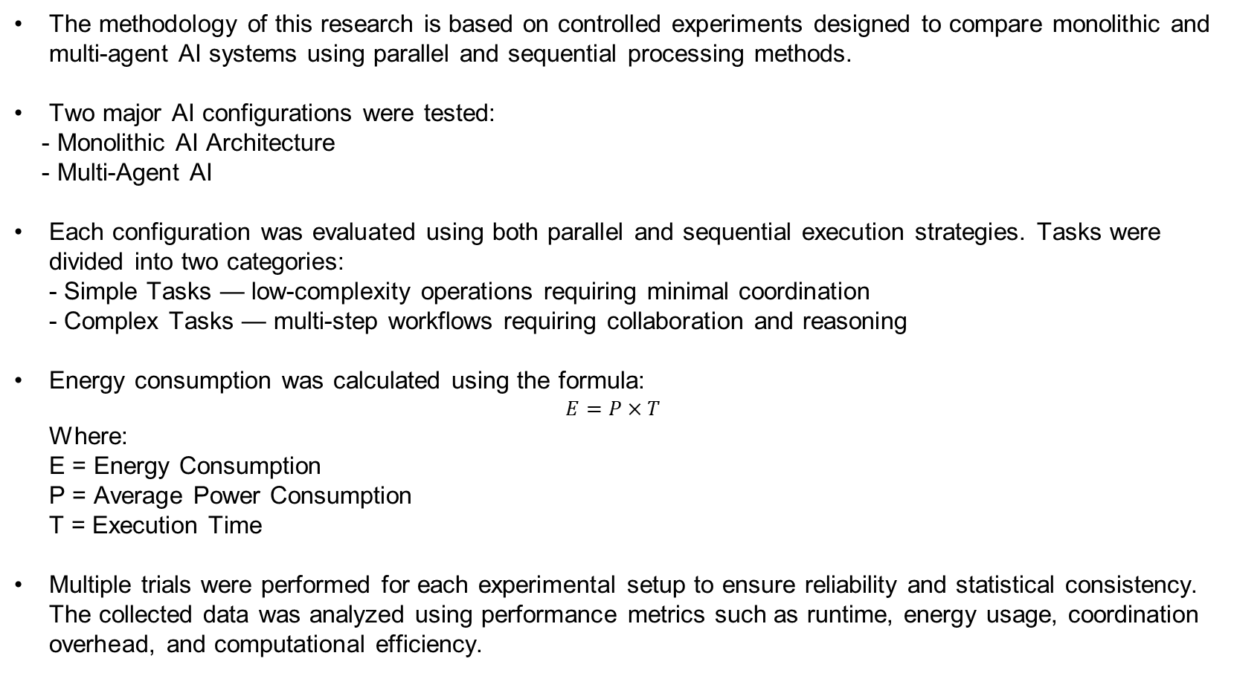
Methodology
The methodology of this research is based on controlled experiments designed to compare monolithic and multi-agent AI systems using parallel and sequential processing methods.
Two major AI configurations were tested:
- Monolithic AI Architecture
- Multi-Agent AI
Each configuration was evaluated using both parallel and sequential execution strategies. Tasks were divided into two categories:
- Simple Tasks — low-complexity operations requiring minimal coordination
- Complex Tasks — multi-step workflows requiring collaboration and reasoning
Energy consumption was calculated using the formula:
$$E=P×T$$
Where:
E = Energy Consumption P = Average Power Consumption T = Execution Time
Multiple trials were performed for each experimental setup to ensure reliability and statistical consistency. The collected data was analyzed using performance metrics such as runtime, energy usage, coordination overhead, and computational efficiency.

Slide 7
System Architecture
The system architecture is designed to evaluate the performance and efficiency of different AI configurations under controlled experimental conditions.
The process begins with the Task Input Module, which accepts tasks of varying complexity, ranging from simple text generation to complex multi-step workflows such as software development and reasoning tasks.
The Decision Engine analyzes the complexity of the task and determines whether it should be executed using a monolithic model or a multi-agent architecture. This decision depends on factors such as computational cost, task requirements, and resource availability.
In the Processing Module, tasks are either handled entirely by a monolithic model or divided among multiple specialized agents. In the multi-agent approach, tasks are distributed into subtasks assigned to different agents.
The Communication Module manages the exchange of intermediate results, synchronization data, and coordination messages among agents. This communication process contributes to additional energy consumption known as the energy tax.
The Monitoring and Analysis Module records execution metrics including CPU usage, GPU utilization, runtime, and energy consumption using CodeCarbon technology. These metrics are then analyzed to compare system performance across different processing strategies.

Slide 8
Results- Carbon Reduction
The experimental findings reveal important differences between monolithic and multi-agent AI systems.
For low-complexity tasks, monolithic systems achieved better performance because they avoided coordination overhead and completed tasks faster with lower energy consumption. Multi-agent systems consumed additional energy due to communication between agents, even when using sequential execution.
For medium-complexity tasks, both architectures produced acceptable results, but multi-agent systems generated more reliable and refined outputs because specialized agents could verify and improve intermediate results.
For high-complexity tasks, multi-agent systems significantly outperformed monolithic systems in terms of accuracy, reliability, and iterative reasoning capabilities. The collaborative structure enabled better handling of multi-stage workflows and error correction processes.
However, the improvement in performance came at the cost of higher energy usage. Inter-agent communication created an “energy tax,” particularly during parallel execution, where simultaneous processing increased resource consumption.
The study concludes that monolithic systems are better suited for simple workloads, while multi-agent architectures are more effective for complex tasks despite their higher energy requirements.

Slide 9
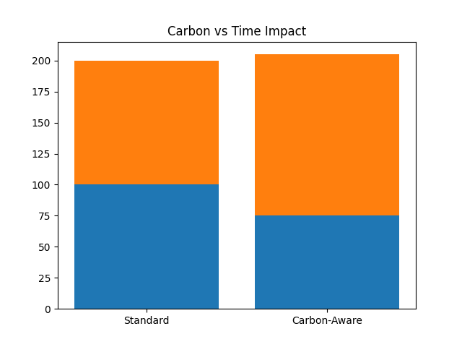
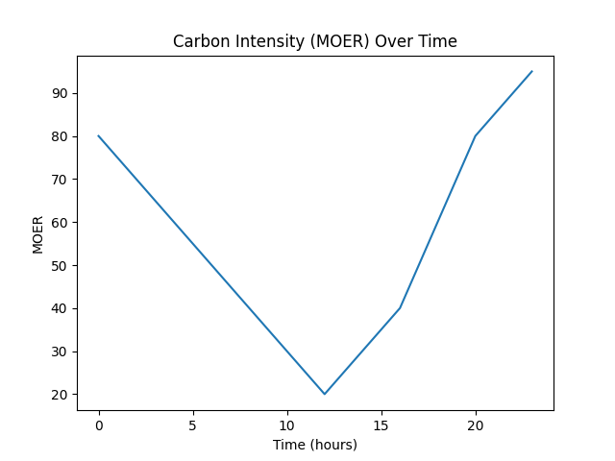
Graph Demonstration

Slide 10
Conclusion
This research provides a comprehensive comparison between monolithic and multi-agent AI systems, focusing on the relationship between performance, energy consumption, and processing efficiency.
The study demonstrates that monolithic systems are highly efficient for simple tasks because they eliminate communication overhead and achieve faster execution with lower energy usage.
In contrast, multi-agent systems perform significantly better for complex tasks that require iterative reasoning, collaboration, validation, and refinement. Their distributed structure improves accuracy and reliability but introduces higher energy costs due to inter-agent communication.
Parallel processing reduces execution time but increases energy consumption, whereas sequential processing improves coordination while increasing runtime.
The findings emphasize the importance of balanced AI system design. Instead of relying exclusively on one architecture, future AI systems should adopt adaptive hybrid approaches capable of dynamically selecting the most efficient strategy according to task requirements.
Overall, the research contributes valuable insights into sustainable AI and highlights the growing importance of balancing computational performance with environmental responsibility.

Slide 11
Future Work
Future research aims to improve the efficiency and sustainability of AI architectures through adaptive hybrid systems capable of dynamically selecting the most suitable processing approach based on task complexity and resource availability.
One major area of improvement involves optimizing communication between agents. Techniques such as compressed data transfer, selective synchronization, and interval-based communication can reduce the energy tax associated with distributed AI systems.
Another important direction is hardware-aware optimization. Better utilization of GPUs, TPUs, and distributed computing infrastructure can significantly improve performance while reducing energy consumption.
Future studies may also extend evaluations to real-world domains such as robotics, healthcare, natural language processing, and computer vision to assess system robustness and scalability under practical conditions.
In addition to measuring energy consumption, future research should include sustainability metrics such as carbon footprint, resource utilization, and environmental impact assessment.
Advanced learning approaches such as reinforcement learning and meta-learning may further improve the adaptability and intelligence of multi-agent systems.

Slide 12
References
[1] S. Russell and P. Norvig, Artificial Intelligence: A Modern Approach, 4th ed. Pearson, 2020.
[2] I. Goodfellow, Y. Bengio, and A. Courville, Deep Learning. MIT Press, 2016.
[3] J. Dean and S. Ghemawat, “MapReduce: Simplified Data Processing on Large Clusters,” Communications of the ACM, vol. 51, no. 1, pp. 107–113, 2008.
[4] T. N. Kipf and M. Welling, “Semi-Supervised Classification with Graph Convolutional Networks,” International Conference on Learning Representations (ICLR), 2017.
[5] D. Silver et al., “Mastering the Game of Go with Deep Neural Networks and Tree Search,” Nature, vol. 529, pp. 484–489, 2016.
[6] R. Sutton and A. Barto, Reinforcement Learning: An Introduction, 2nd ed. MIT Press, 2018.
[7] R. Schwartz, J. Dodge, N. A. Smith, and O. Etzioni, “Green AI,” Communications of the ACM, vol. 63, no. 12, pp. 54–63, 2020.
[8 ] A. Lacoste, A. Luccioni, V. Schmidt, and T. Dandres, “Quantifying the Carbon Emissions of Machine Learning,” NeurIPS Workshop, 2019.
[9] Y. Shoham and K. Leyton-Brown, Multiagent Systems: Algorithmic, Game-Theoretic, and Logical Foundations. Cambridge University Press, 2009.
[10] L. N. Vicente and P. H. Afonso, “Energy Efficiency in Distributed Artificial Intelligence Systems,” IEEE Transactions on Sustainable Computing, vol. 6, no. 3, pp. 450–462, 2021.

Slide 13
Thank You
13

